Slide 1
Damn Vulnerabilities Web Application

Slide 2
DVWA
DVWA stands for "Damn Vulnerable Web Application."
It is a deliberately vulnerable web application used for educational and security testing purposes.
Developed to help individuals learn about web application security by exploring and exploiting its vulnerabilities.

Slide 3
INSTALLATION
https://www.kalilinux.in/2020/01/setup-dvwa-kali-linux.html
All the steps are given in the website

Slide 4
SETUP BURPSUITE
In Firefox, go to the Firefox Menu and select settings.
Go to network settings.
Set manual proxy.

Slide 5
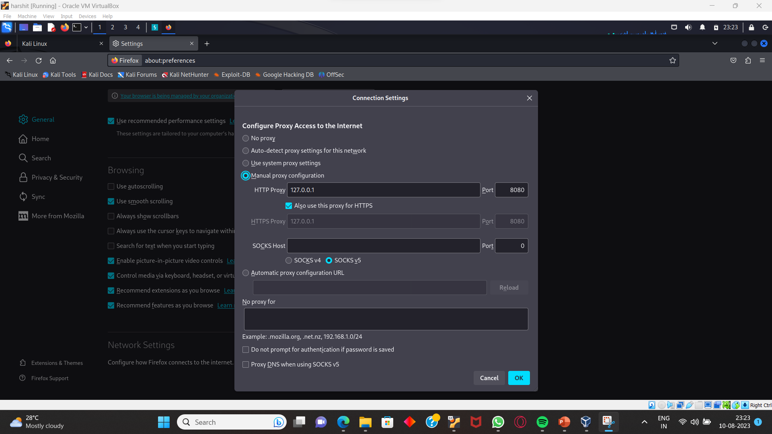
SET AS FOLLOWS

Slide 6
DOWNLOAD CERTIFICATES
DOWNLOAD CERTIFICATE BY TYPING [http://burpsuite]
Go to settings and search CERTIFICATES.
Select import and import the certificates.
DONE.

Slide 7
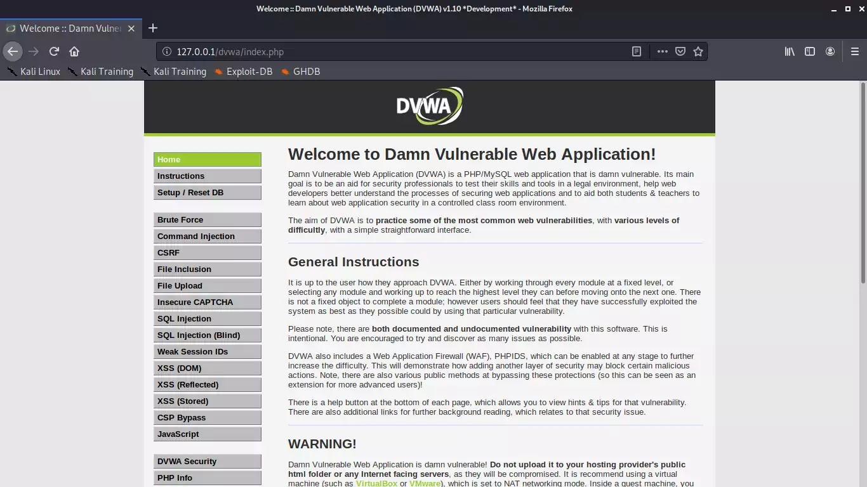
Search 127.0.0.1/dvwa Select DVWA Security and set it to low

Slide 8
START BURPSUITE
CLICK ON PROXY
PUT INTERCEPT TO ON

